Slide 1
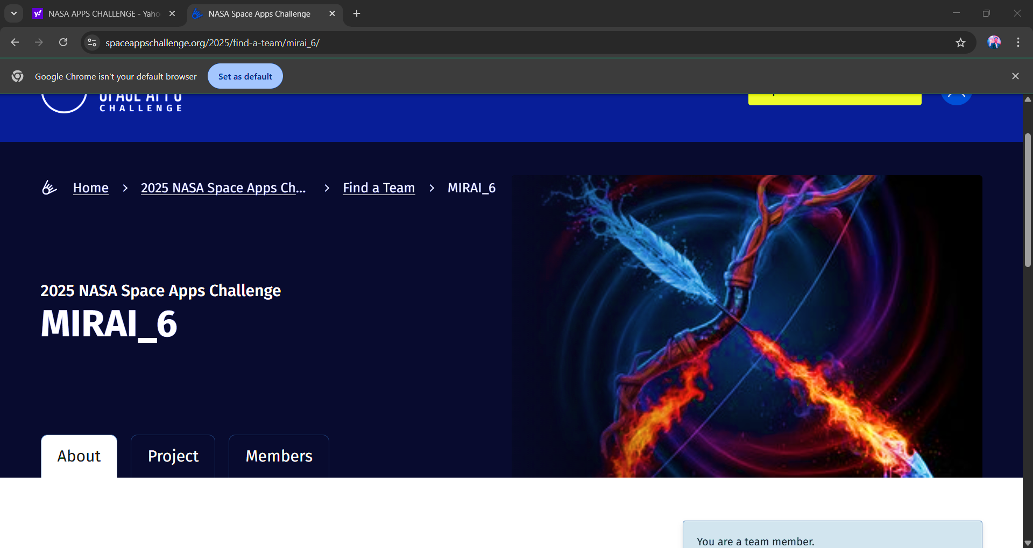
TEAM :MIRAI_6
PROBLEM STATEMENT :
Challenge to Build a Space Biology Knowledge Engine
TEAM MEMBERS :
ASHOK MB
DHANUSH S
K VINAY MADHAV
P YOGESHWAR
RAKESH C

Slide 2
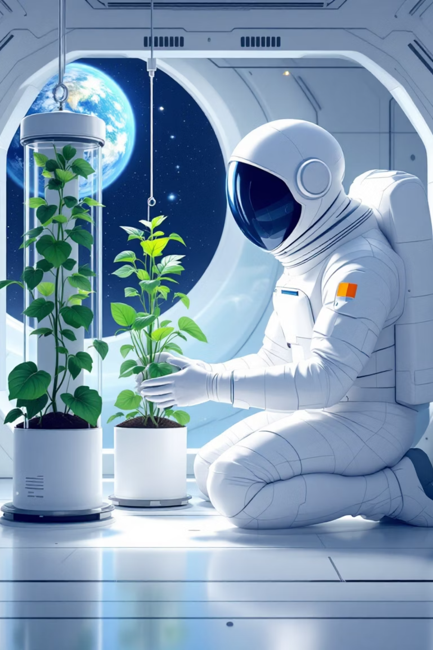
The Space Biology Knowledge Engine
IDEA
Idea is to turn NASA's massive library of biological data into an intelligent, instantly searchable, and interconnected knowledge base to accelerate human space exploration.

Slide 3

FEATURES OF THE WEBSITE
*AI-Powered Search*- Semantic search across publication titles and abstracts- Filter by research areas, organisms, and space missions- Relevance-based ranking using TF-IDF and cosine similarity
*Interactive Dashboard*- Research trends analysis over time- Publication distribution by category- Real-time statistics and metrics
*AI Insights*- Automated analysis of research patterns- Key findings extraction- Trend identification and gap analysis
*Knowledge Graph*- Interactive network visualization- Relationship mapping between publications- Category and tag-based connections
*Data Visualization*- Publication trends over time- Research area distribution- Interactive charts and graphs

Slide 4
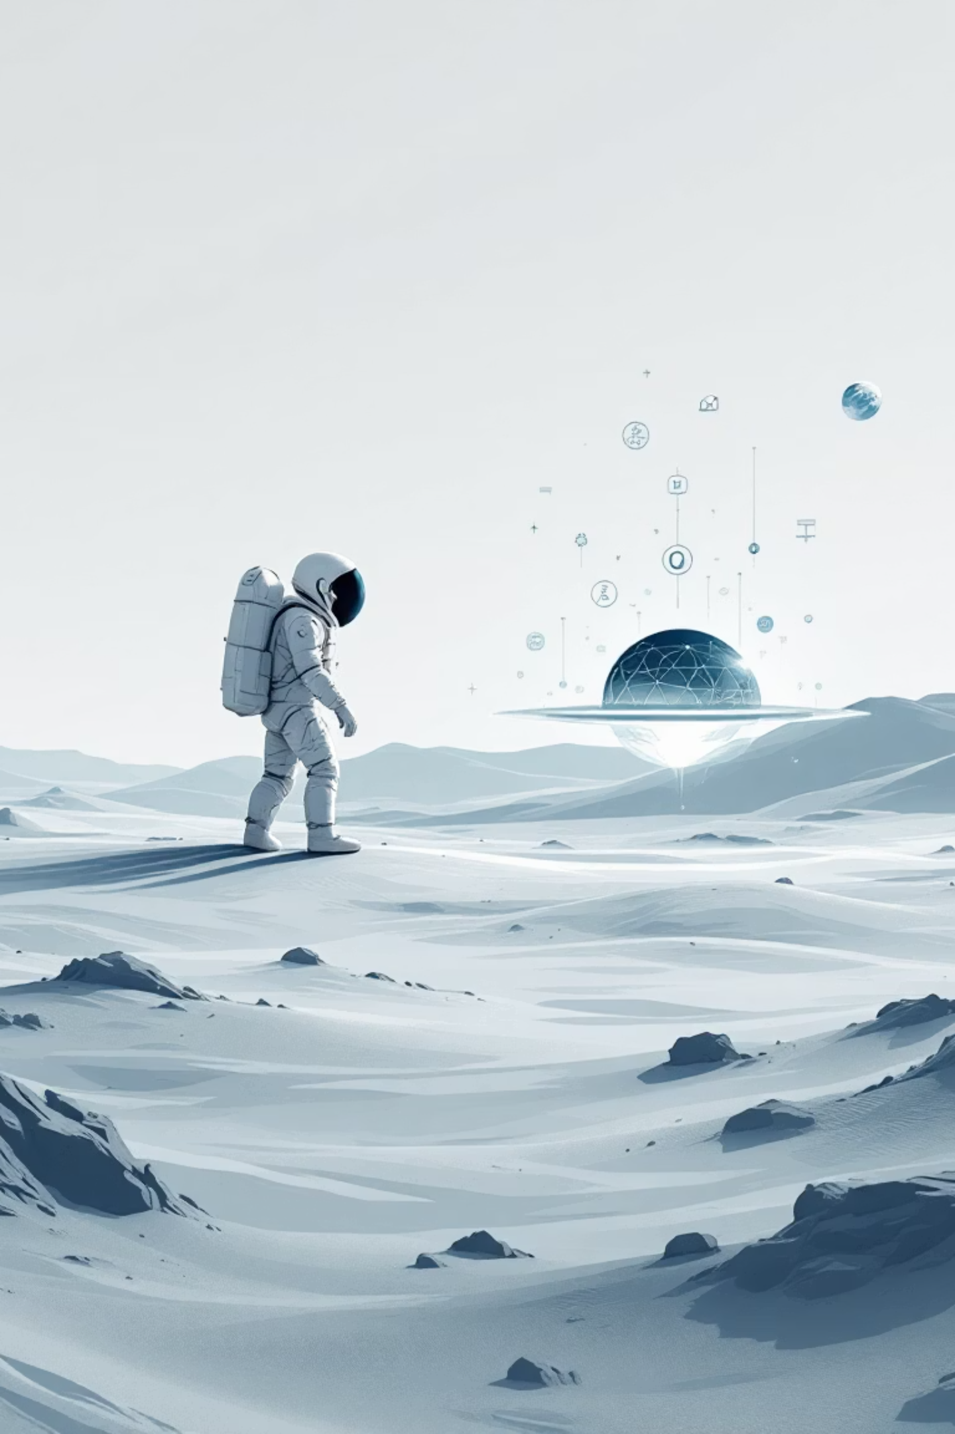
POTENTIAL IMPACT:
Accelerates Scientific Discovery
Supports Human Spaceflight
Increases Accessibility
Knowledge Management

Slide 5



Technology Stack-
Frontend: HTML5, CSS3, JavaScript, D3.js, Plotly.js-
Backend: Python Flask, RESTful API-
AI/ML: scikit-learn, NLTK, TF-IDF, cosine
Data Processing: pandas, numpy
Knowledge Graph: NetworkX
Visualization: D3.js, Plotly.js
AI-Tools Used
LLM(LARGE LANGAUGE MODELS)
KNOWLEDGE GRAPHS

Slide 6
PROJECT DEMONSTRATATION
Website link
NASA Space Biology Knowledge Engine

Slide 7
REFERENCES
Github
GitHub - 06bhardwaj/Nasa
Website
NASA Seeks Innovators for Lunar Waste Competition - NASA
The NASA Task Book

